Slide 1
ROTARY CLUB OF NAIROBI
COMMUNITY SERVICE COMMITTEE PROJECTS 2023/24

Slide 2
Thematic Areas for Projects
Health for all
Dignity to the youth
Touching school children lives
Addressing climate change
Providing psycho-social support

Slide 4
Rural Blindness Eradication
RCN has been saving eye sight through cataract surgery for those in need. The eye camps reach deserving cases from marginalized communities.
This is now widely accepted as a RCN flagship project
The year’s target is to conduct 800 cataract surgeries through partnerships with medical team to offer the sight-saving operation.
Already 153 surgeries have been conducted in Garissa (July 2023)
Team leads - Rtn Laura and PP Salim

Slide 5
Our youngest recipient of a successful eye surgery – July 2023 Garissa eye camp
Before…
After

Slide 6
Polio is a debilitating illness that can lead to paralysis and even death. Unfortunately Kenya has in the very recent past confirmed polio cases among young children an the government to planning to conduct a Polio campaign.
To remind the community of the importance of vaccinating children against Polio, Community service together with Youth service will organize an exciting Football tournament, with edutainment on Polio.
Dr. David Githanga is one of the Globally recognized experts on this subject matter and also the Face of Kick Polio Out in Rotary
Team lead – Rtn Huma and PP Githanga

Slide 8
Empowering young people with income generating skills
Wezesha Bado Institute is a social enterprise that seeks to solve the social problem of youth unemployment in Kenya by bridging the skills gap.
It has set up a Skills Development Centre of Excellence (SDCE) in Kitengela at the EPZ plaza. It provides up-to-date, relevant and practical training and capacity building for the various segments of the apparel manufacturing sector in Kenya.
RCN is supporting 50 young people (age between 18 – 30 years) for a 2-month training at Wezesha Bado institute that will potentially lead to their employment.
Training started on 7th August.
Team lead – Rtn Rajeev

Slide 9
Menstrual Hygiene Management - MHM
The MHM Project aims to address the lack of access to menstrual hygiene products faced by girls and women in underserved communities.
Girls will receive inner garments, along with reusable sanitary products and to help break the stereotype of period shaming and the assumption that menstruation is solely a gender issue boys will also be provided with inner wear. This approach ensures that both genders receive necessary hygiene products
Six months after the initial distribution, a follow-up visit is conducted to assess the impact of the project and ensure the participants stay well-informed.
By providing menstrual hygiene products and education, girls and young women are empowered to manage their periods with dignity, and eliminate period-related stigmas.
Team lead – Rtn Eileen

Slide 11
School Children Around the World - SCAW
The project, done with support by Rotarians from Canada, aims to provide a good night sleep to school going children aged 7-10 through distribution of bed-kits to the children at their respective schools.
We are targeting a total of 9,000 students from deserving schools in Kenya.
Planning for this project is underway due to the logistics required for successful implementation in February 2023
Team lead – Rtn Nelson Mburu

Slide 12
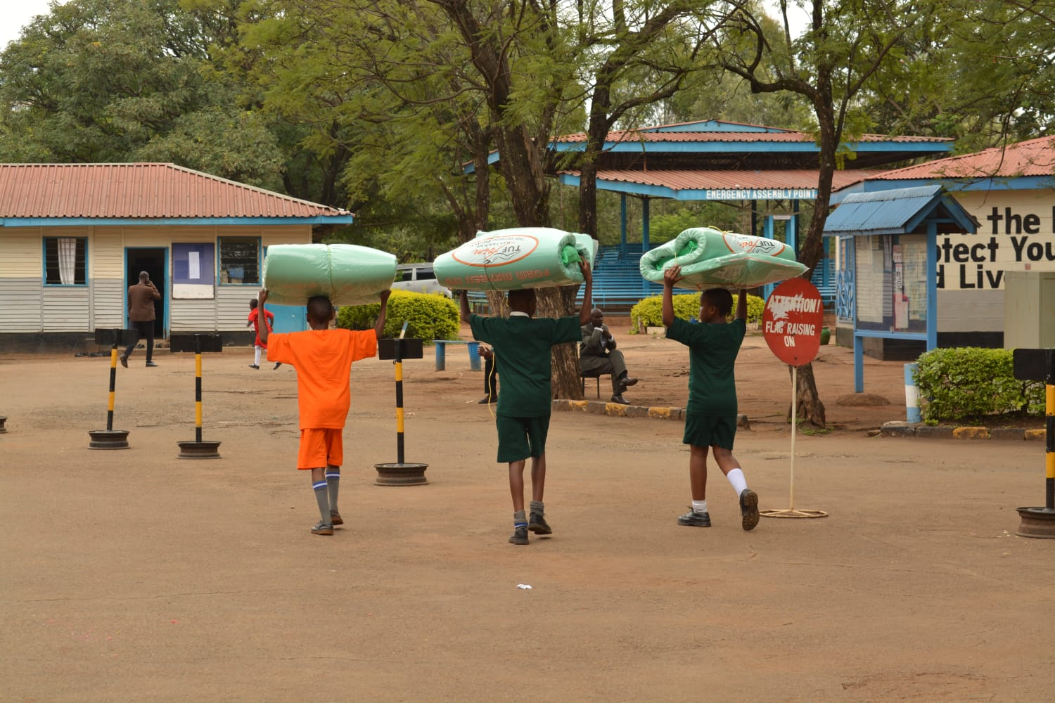

Slide 13
Adopt a school project
While undertaking SCAW in early 2023 RCN identified Bondeni primary school. It serves more than 3,000 students and is a school in dire facilities to make the environment more conducive to teaching and learning.
This is a school that serves an extremely underserved community: where to have a meal a day is a luxury for some of the students. The school remains to most of the students - the only hope for them for a brighter future.
The proposal is ambitious - Adopt the school and support the building of a sanitation block, multipurpose hall and a kitchen.
Lead – Rtn Nicodemus and Rtn Mumbua

Slide 15
Growing Trees
Tree growing is a signature project activity of our club. For this year we have two modalities of tree growing:
1. We shall support tree growing initiatives that are sustainable through partnership with schools that have interact clubs. Together with the Rotaractors, RCN shall work with he tstudents to nurture and care for the trees.
2. RCN received a donation of Kshs. 1 million worth of tree seedlings from Rtn. Devani’s mother’s trust. It was indicated that the donation be deployed at Konza technopolis (there had been drought & need for afforestation).
The plan is to grow Fruit trees together with Indigenous trees in the Botanical & Peace Garden over 5 years.
Team leads – Rtn Eileen, Rtn Huma

Slide 16
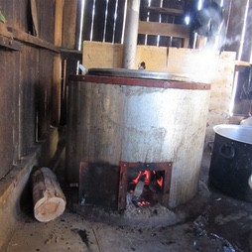
Energy Saving Jiko
Cooking in schools is done with wood or charcoal fuel. To reduce quantities of wood/charcoal and energy consumed RCN has been collaborating with schools to install energy saving jikos.
The school covers half of the cost for a jiko and RCN covers the other half. This is done for school ownership and accountability of the jiko.
The jikos are sourced from local jua-kali artisans which provides much needed revenue to them - a win-win situation.
Team lead – Rtn Atia

Slide 17
Hydroponics
Hydroponics is the technique of growing plants using a Water - based nutrient solution rather than soil, it can include an aggregate substrate or growing media.
This is an innovative project that looks at empowering communities to address food insecurity.
The committee will work together with an expert on the subject matter and implement it in a community and follow-up
Team lead – Rtn Laura

Slide 19
Support for Alcoholics and substance abuse addicts - Embakasi
This group assists drug and alcohol addicts as they are rehabilitated.
We engaged with them (for the first time) in 2022 during the drought response organized by RCN.
Due to the overwhelming positive impact that support had on the community – the group has again reached out for help – this time bigger including food distribution request and purchase of land with construction of a rehabilitation space.
Discussions are on-going to manage the expectations by the group to enable us to focus support that RCN can deliver.
Team lead – Rtn. Laura

Slide 20
APPEAL TO MEMBERS
RCN impact in the community is felt when members roll up their sleeves and take part in projects that have been selected and endorsed by Community service committee and approved by the Board.
We need members to turn up and support each of the projects by joining and assisting with planning and implementation.
The core of Rotary Club of Nairobi is Community service – that is our DNA, lets serve, touch a community and support each other to make the load lighter.

Slide 21
WHAT IT ENTAILS TO SUCCESSFULLY IMPLEMENT A PROJECT
1. Liaise with the community focal person on the ground to:
conduct a site visit and
to identify the areas that will be supported,
make a list of what resources are required,
prepare a baseline analysis that will be deliberated on during the community service committee meeting
2. Select a team that will assist in ensuring the projects gets off the ground from when implementations begins till completion.
3. Liaise with the fund raising committee and the board so that the project is funded
4. Work closely with the treasurer who will facilitate transfer of funds for the projects
5. During implementation participate and keep abreast of all on-going developments including financial expenditure while staying on track
6. Sign off the project once complete and liquidate all expenditure and payments to vendors.
7. Provide a report of the project – complete with pictures and if possible short videos to show the “before and after”

